Slide 1
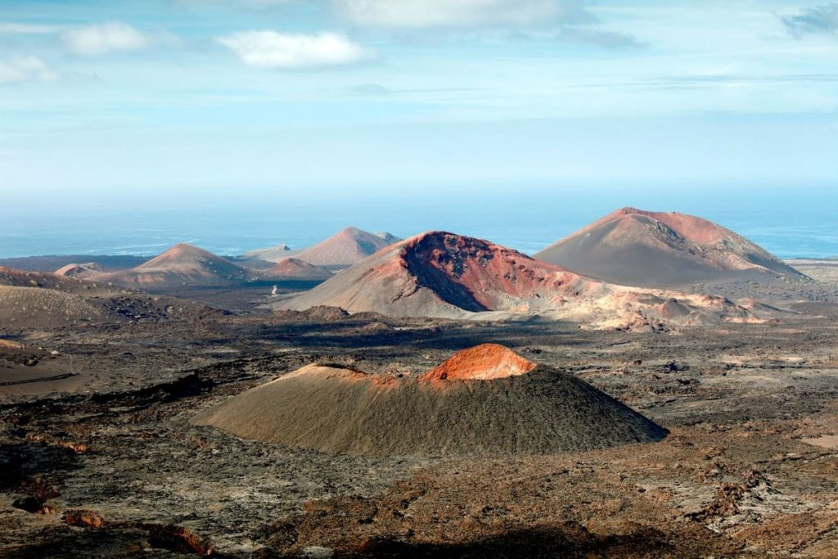
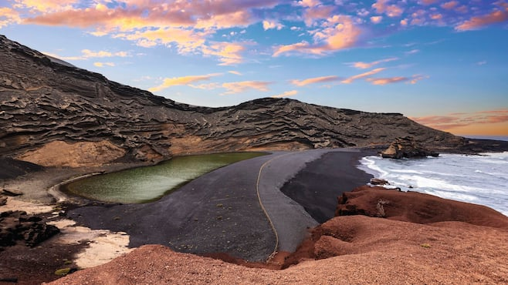






SGROUP BIP ON INTERNATIONALISATION FOR LO’S
ULPGC
Campus Lanzarote
May 2024

Slide 2
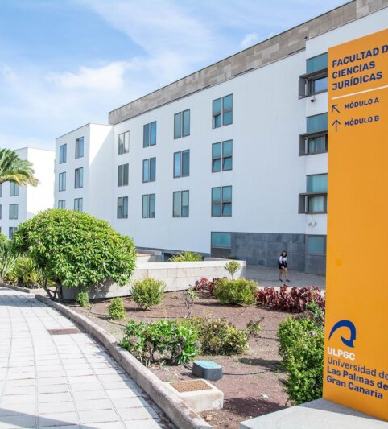


About ULPGC:
The University of Las Palmas de Gran Canaria (ULPGC) is a public university based in the city of Las Palmas de Gran Canaria and with campuses on the islands of Gran Canaria, Lanzarote and Fuerteventura that was created on April 26, 1989. It is the largest university in the Canary Islands with over 20.000 students. The ULPGC offers 51 Bachelor Degrees, 24 Masters and 13 PhD Programmes. It stands out for its degrees in the area of ​​engineering and health sciences, with innovative studies within the Spanish higher education panorama, such as the Degree in Data Science and Engineering or Marine Sciences, in addition of a growing offer of online degrees on its virtual campus.
Head office: Juan de Quesada, 30, 35001 Las Palmas de Gran Canaria Spain

Slide 3
About SGroup:
a dynamic
Universities in
The SGroup -
Europe is an international
network with over 30 years of experience in university
collaboration within Europe and beyond: 48 higher education institutions from 23 European countries and 6 countries outside Europe.
Its aim is to foster university excellence in education and research and to promote the continuous adjustment to educational and societal needs in a creative and innovative way.
Its mission is based on four core areas of cooperation: internationalisation strategy, academic collaboration, academic mobility, and transfer of knowledge.

Slide 4
01 02 03 04
Programme Lanzarote & Arrecife Arriving Hotels
05 06 07
Useful Info Weather Month Information and Contacts

Slide 5

March 19th, 2024
March 19th, 2024
(online)
Virtual Session
Programme
11.30 Project Meeting
Speaker: Mar Fernandez
Zoom Link: https://www.google.com/url?q=https://us06web.zoom.us/j/88494335067?pwd%3DNxRRk1CVaKckhfttQkpSeuBMVyuweP.1&sa=D&source=calendar&usd=2&usg=AOvVaw24ITcxZ-pjCH2cnwgP0L8O

Slide 6

Monday, 6 May, 2024
Venue: Cabildo de Lanzarote
Avenida Fred Olsen, s/n. Arrecife
08:30 Registration of Participants
09:00 Welcome words by the President of the Island Council, the Rector of the University and by the SGroup President
09:30 Session 1: SGroup Internal Projects – Report
Speakers: Bárbara Costa (SGroup); Mar Fernandez (UVa)
11:00 Coffee break
11:30 Session 2: SGroup International Projects - Workshop and Discussion
Moderator: Mar Fernandez (UVa)
14:00 Lunch (Monumento al Campesino, by bus)
16:00 Back to Arrecife and free time
FACE
TO
FACE
SESSIONS
Monday, 6 May
Programme
University of Las Palmas
de Gran Canaria
Campus Lanzarote, Arrecife

Slide 7

Tuesday, 7 May, 2024
Venue: Escuela de Turismo ULPGC, Tahiche
08:30 Pick up bus at “Intercomunicador”
09:00 Welcome Words and brief presentation by the Escuela de Turismo ULPGC
09:15 Session 3: Successful organization of BIPs |How IROs may support Academics in the implementation of BIPs
Speakers: Mar Fernandez (UVa); Rebeca Tomás (URV)
10:30 Coffee break with academics and staff.
11:00 Session 4: SGroup EU Projects ICI and DITE – Open Seminar
Speakers: Malka San Lucas (URV); Małgorzata Kopalska (USZ)
Workshop on how to involve SGroup members in the running EUProjects
Moderator: Małgorzata Kopalska (USZ)
13:00 Lunch at Tahiche
13:45 Departure for Los Jameos del Agua y La Cueva de los Verdes
20.00 Back to Arrecife
Free time for dinner
FACE
TO
FACE
SESSIONS
Tuesday, 7 May
Programme
Escuela de Turismo, Tahiche
University of Las Palmas
de Gran Canaria
Campus Lanzarote

Slide 8

Wednesday, 8 May, 2024
Venue: Islote de la Fermina, Arrecife
09:00 Session 5: Cooperation Beyond Europe
Successful cooperation with Africa
Speakers: Javier Ponce (ULGPC); Oriana Bertucci (U.Liège)
Moderator: Robert Kotzé (U.Stellenbosch, South Africa)
10:30 Coffee break with academics and staff
11:00 Session 6: Interactive session on Inclusion of Incoming and Outgoing Mobility Students and Staff
Speaker: Coralie Ostertag (U.Lille)
12:00 Session 7:Brief cultural presentation
5’ presentation by Aleksandra Banic; Hector Fernández Manchado (CEO SPEL); URV; Ruta Jankauskiene; Robert Kotzé; Catania
Workshop on Intercultural Preparation – Sharing best practices
Speakers: Oriana Bertucci (U.Liège); Ruta Jankauskiene (U. Kaunas); Blanca Ramírez (URV); Thibault HOYER (U.Rouen)
Moderator: Aleksandra Banic (U.Split)
13:00 Departure by bus to the National Park of the Mountain of Fire
13:30 Lunch at the Montaña de Fuego
14:00 Visit to the Montaña de Fuego
20.00 Back to Arrecife
Free time for dinner
FACE
TO
FACE
SESSIONS
Wednesday, 8 May
Programme
University of Las Palmas
de Gran Canaria
Campus Lanzarote, Arrecife

Slide 9
Thursday, 9 May, 2024
Venue: Islote de la Fermina, Arrecife
08:30 Session 8: Sharing Best Practices from EU Alliances
Speakers: Blanca Ramírez (URV - AURORA); Frederik De Decker (UGhent – online, ENLIGHT); Thibault HOYER (U.Rouen, INGENIUM University); Grzegorz Kłapyta (Silesian - EUREKA); Robert Kotzé (U.Stellenbosch, EUTOPIA)
10.00 Workshop: Synergies between EU Alliances and SGroup
Moderator: Bárbara Costa
10:30 Coffee break
11:00 Session 9: Building Projects Together
Speaker: Aleksandra Banic (U.Split)
13:00 Free Time for Lunch and Other Activities
20:00 Gala Dinner at Castillo de San José
FACE
TO
FACE
SESSIONS
Wednesday, 8 May
Programme
University of Las Palmas
de Gran Canaria
Campus Lanzarote, Arrecife

Slide 10
Friday, 10 May, 2024
Venue: Islote de la Fermina, Arrecife
09:00 Session 10: Workshop on how to build projects together
Moderator: Aleksandra Banic (U.Split) or Bárbara Costa
11:00 Coffee break
11:30 Wrap up and conclusions
Speaker: Mar Fernandez
13:30 Delivery of BIP Certificates
FACE
TO
FACE
SESSIONS
Wednesday, 8 May
Programme
University of Las Palmas
de Gran Canaria
Campus Lanzarote, Arrecife

Slide 11
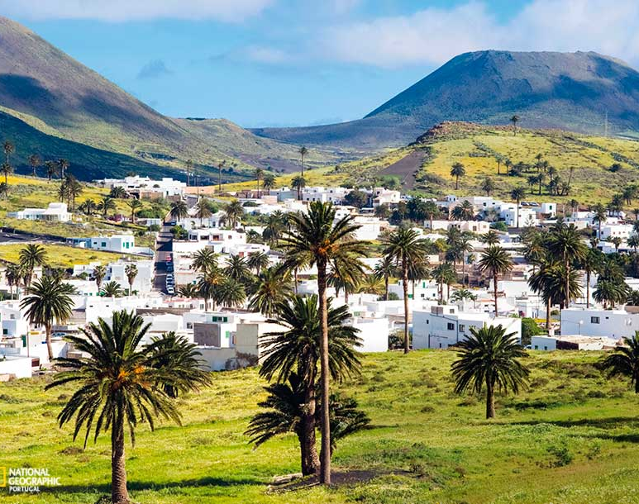
02
About Lanzarote:
The University of Las Palmas de Gran Canaria (ULPGC) is a public university based in the city of Las Palmas de Gran Canaria and with campuses on the islands of Gran Canaria,
Lanzarote is the Canary archipelago’s south-easternmost island. Although it covers no more than 800 square kilometres, it offers strikingly diverse landscapes. The legacy of the volcanic eruptions that took place in the 18th and 19th centuries is a spectacular scene of singular form and beauty. Next to unexpected landscapes made up of volcanic caves, lakes of lava and craters, lie beaches of golden sand and transparent waters.
What is more, the spectacular natural heritage has been jealously guarded by the people of Lanzarote; and not in vain, since the island was declared a Biosphere Reserve by UNESCO in 1993. Furthermore, in 2015, it became the first destination in the world to receive Biosphere Responsible Tourism certification.
The Parque Nacional de Timanfaya, (Timanfaya National Park), a lovely succession of volcanic landscapes, is one of the island’s greatest tourist attractions, together with the Art, Culture and Tourism Centres created by the local artist César Manrique.
The benign climate, with its average annual temperature of 22º C, is also worthy of mention, since it makes Lanzarote the perfect destination for the practice of all kinds of outdoor sports.

Slide 12
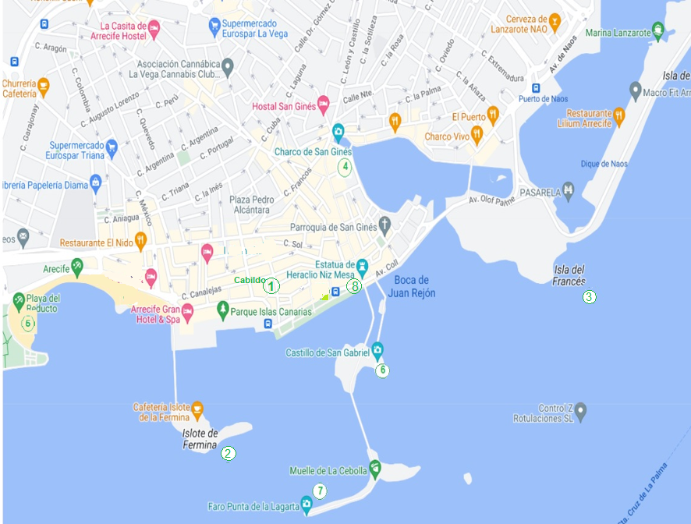

02
The city of
Arrecife
(City Center)
Rectorate of the University of Valladolid
1 Cabido de Lanzarote
2 Islote de Fermina
3 Isla del Francés
4 Charco de San Ginés
5 Playa del Reducto
6 Castillo de San Gabriel
7 Faro Punta de La Lagarta
8 Estatua de Heracio Niz Mesa

Slide 13
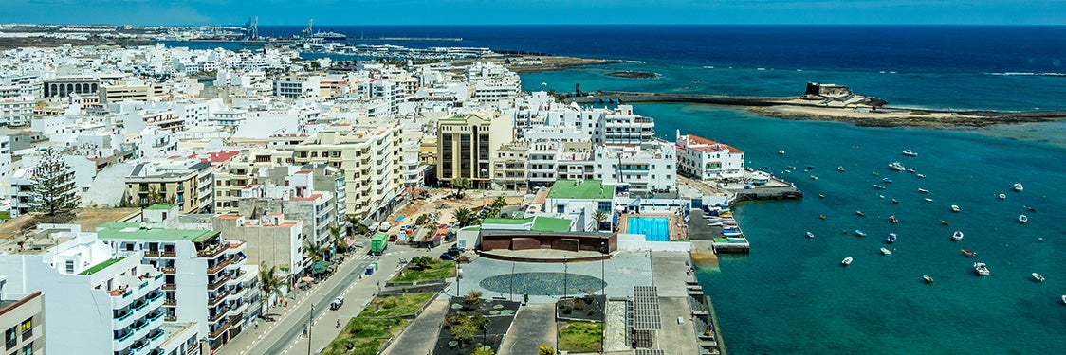
The best way to get to Lanzarote from abroad is by plane via the César Manrique-Lanzarote Airport. The airport is located near Arrecife.
03
Arriving by plane at Lanzarote. From the airport to Arrecife.
There are two bus lines “Intercity Bus Lanzarote” that connect the Airport to Arrecife:
Line 22: Every 25 minutes, Monday - Friday only).
Line 23: Every hour on weekdays and every 50 mins on weekends and holidays.
For time table and purchase your tickets at
https://arrecifebus.com/?option=com_content&view=article&id=2310&lang=es
You can also take a taxi from the Airport to Arrecife. Price: 16-18€

Slide 14
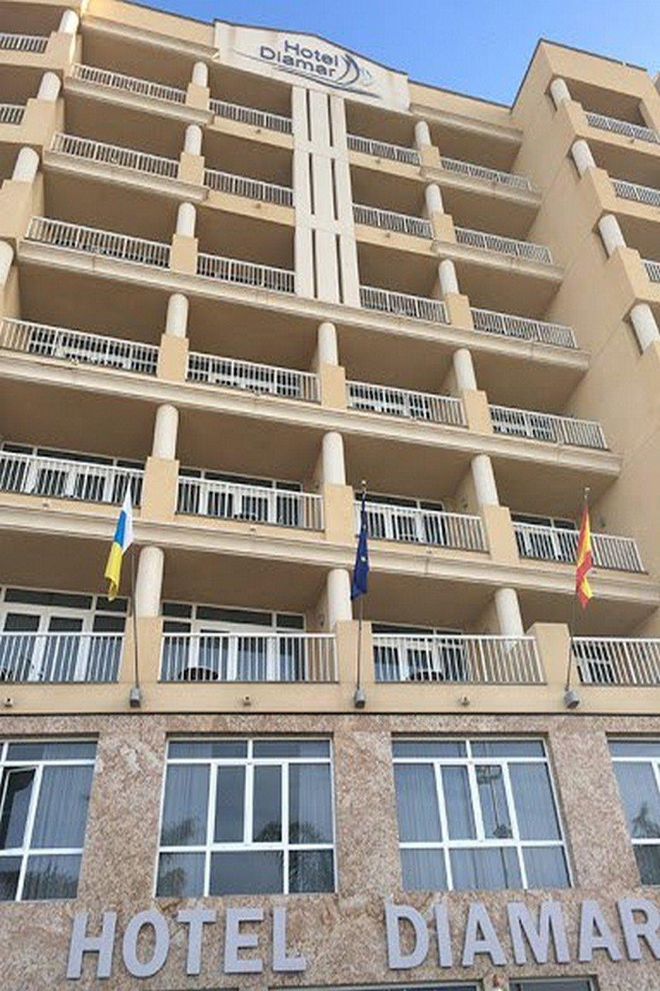
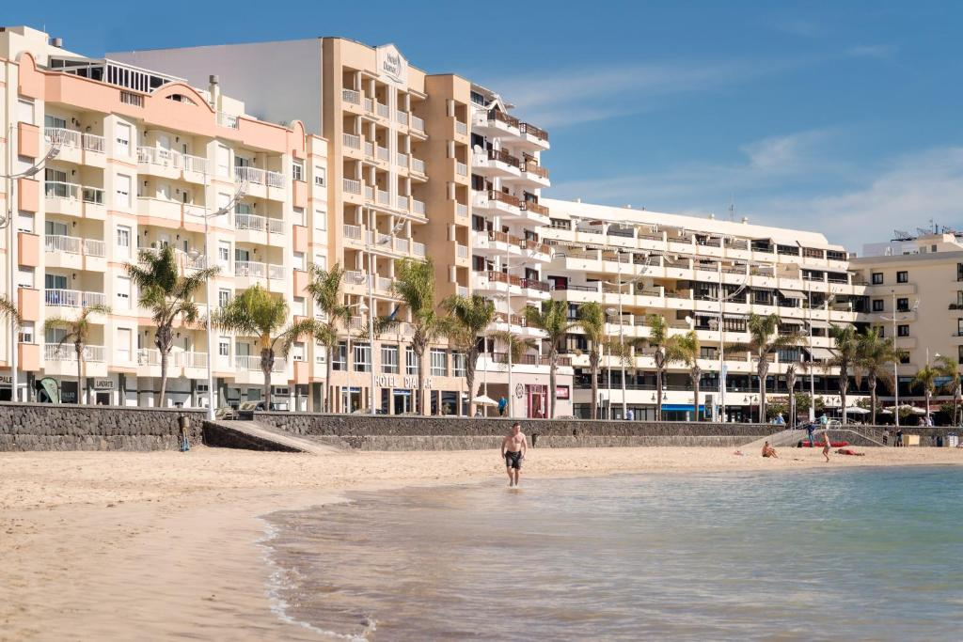
04
Hotels
You are free to book the hotel of your choice in Lanzarote, here is our suggestion
DIAMAR HOTEL
Address:
Av. Fred Olsen, 8, 35500 Arrecife, Las Palmas, Spain

Slide 15
06
Useful info
The event venues are:
Cabildo.
On a walking distance.
Escuela de Turismo.
A bus will take there from the centre of Arrecife.
Islote de la Fermina.
On a walking distance.
MONDAY
TUESDAY
WED, THU, FRIDAY

Slide 16






07
Monday Tuesday Wednesday Thursday Friday
Weather
During the month of May, the average temperature in Arrecife is 20°C during the day. At night, the average law can reach 19ºC.
The weather is comfortable in Lanzarote in May.
The humidity is 80%.

Slide 17



EUROPEAN EMERGENCY NUMBER
112
08
Information and Contacts
TIME
Between late October and late March, the local time in Arrecife is CET (UTC+0h)
LOCAL ARRECIFE POLICE
(+34) 928 811 317
POLICE STATION
(+34) 928 597 107
Emergencies 092
Between late March and late October, the local time in Arrecife is CEST (UTC+1h)
CURRENCY AND BANKING
The currency in Spain is the Euro
TOURISM OFFICE
Av/ La Marina, 8
35500 Arrecife
turismolanzarote.com

Slide 18
S_
See you soon in Arrecife!
BIP Coordinator
Head of the International Relations Office & Secretary of the SGroup
MAR FERNANDEZ
mariamar.fernandez@uva.es
SGroup OFFICE DIRECTOR
BARBARA COSTA
sgroup@sgroup-unis.eu
Eva Crespo Fonte
Eva.crespo@ulpgc.es
Director School of Tourisim, Lanzarote
University of las Palmas de Gran Canaria

